Slide 1
NCI-CBITT
George Zaki and Peng Wang

Slide 2
Push math optimization a bit further
“sinf” & “sqrtf” helped
Add “-use_fast_math”: NaN
sqrt(15625)=125:
w/o use_fast_math: 125
w/ use_fast_math: 124.999992
int(sqrt(15625)):
w/o use_fast_math: 125
w/ use_fast_math: 124

Slide 3
Perf
Initially, it looked serial CPU part is also much faster in Intel from gprof
Use CUDA for everything, so we can use Intel for CPU code
Didn’t help much. Intel is much faster in the OpenMP part. On part with PGI in the serial part.
Bonus: OpenMP works for multi-GPU

Slide 4
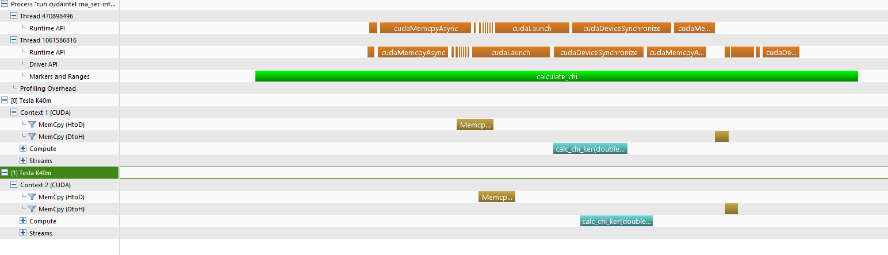

Slide 5
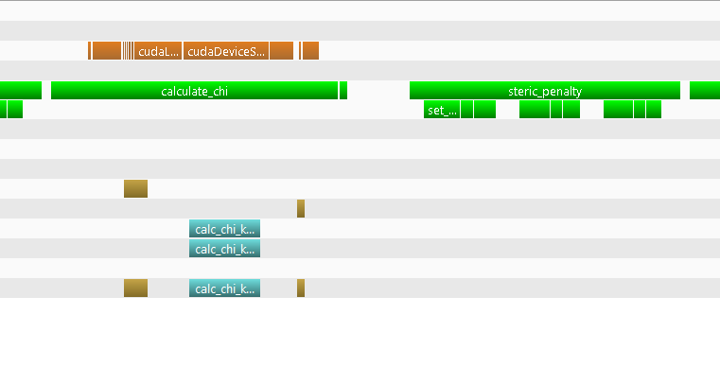
CPU is the bottleneck
Use NVTX to annotate CPU code
Optimize CPU serial code
Add OpenMP to some loops
Reduce redundant computation

Slide 6
Elapsed Time
43% Overall improvement compared to day 1

